Slide 1
eTA
Electronic Travel Advisory
[insert name]
UNDSS [insert country] [insert email]
[insert date of presentation]
Notes:
The purpose of this briefing is to provide information on the UNSMS Electronic Travel Advisory tool, which consists of a mobile APP for all UN System personnel and a desk-top component for UNSMS security professionals.
The following slides describe the features of the eTA mobile APP that every UN System staff is invited to download.

Slide 2
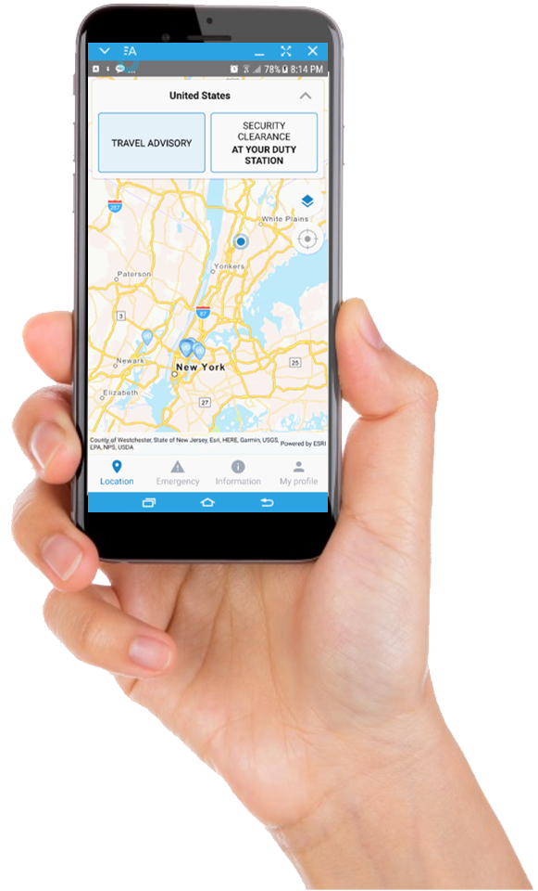
Who is the eTA for?
UNSMS Personnel
Access UNDSS information easily
Receive security notifications, headcount request emergency chat capability
Security Professionals
Enhance security management
Send security notifications using geo-fencing
Allow to account for staff
Facilitate emergency chat
Enable/Disable personnel geo-location in high-risk areas
Reports and statistics
YOUR SAFETY, YOUR SECURITY, OUR PRIORITY
Notes:
Here you can read some of the features of the APP.
The APP, for all personnel, provides information about
Your location and security clearances
Security advisory information
UN premises
Contact information, including emergency contacts, and
Currency exchange rates
The APP also allows you to receive security notifications and respond to headcount requests
The features of the desk-top tool allow security professionals to:
Send security notifications
Send headcount requests asking if users are OK
Locate staff in high-risk areas
Overall, the features included in the APP and desk-top tool improve the communication of vital security information to those who need it – UN System Personnel working worldwide.

Slide 3
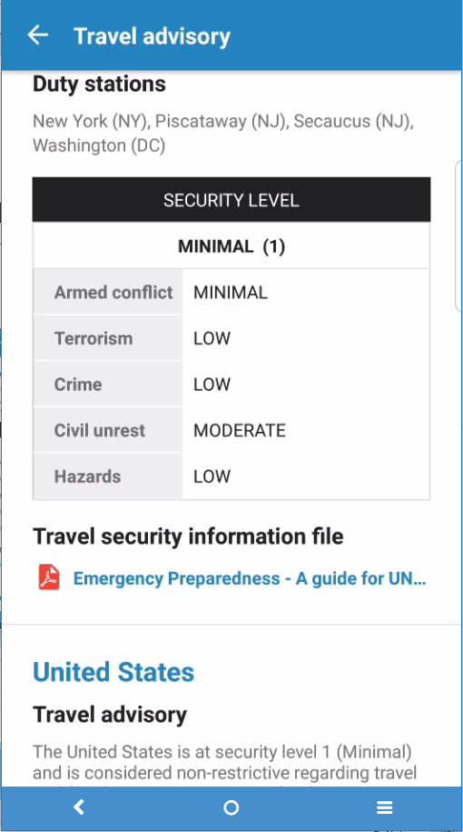
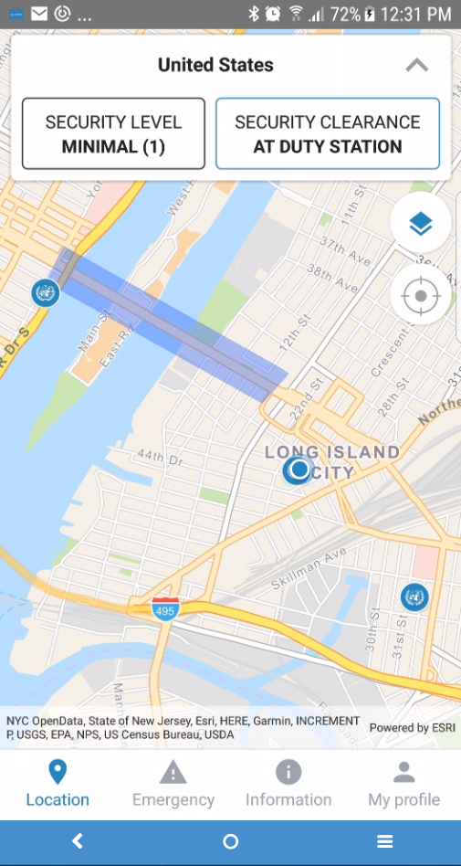
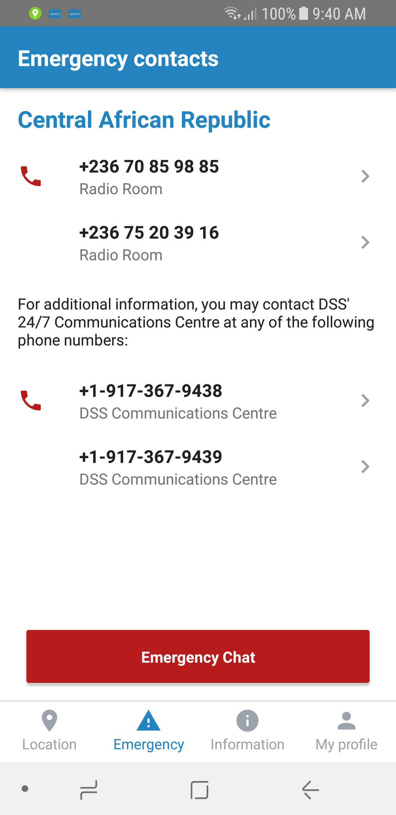
Security-Related Information
Location-based travel advisory
Security clearance status
Emergency details
Closest DSS contact details
UNDSS ComsCen
Emergency chat with UN Security
UN premises locations
Integrates with Google maps for directions
YOUR SAFETY, YOUR SECURITY, OUR PRIORITY
Notes:
Key, security-related information is at your fingertips. The APP knows where you are and is able to provide this information to you, including:
A location-based advisory – this provides you with the security information you need, in the location you’re currently located.
Your security clearance status – if you’re traveling, this will say if you are doing so with or without clearance. If you’re at home, it will show you are at your own duty station.
Emergency details – you will have access to UNDSS local emergency contact details, and a direct line to the 24/7 UN COMSCEN based in New York.
A map-based interface – to instantly orient yourself and get directions to nearby UN locations.

Slide 4
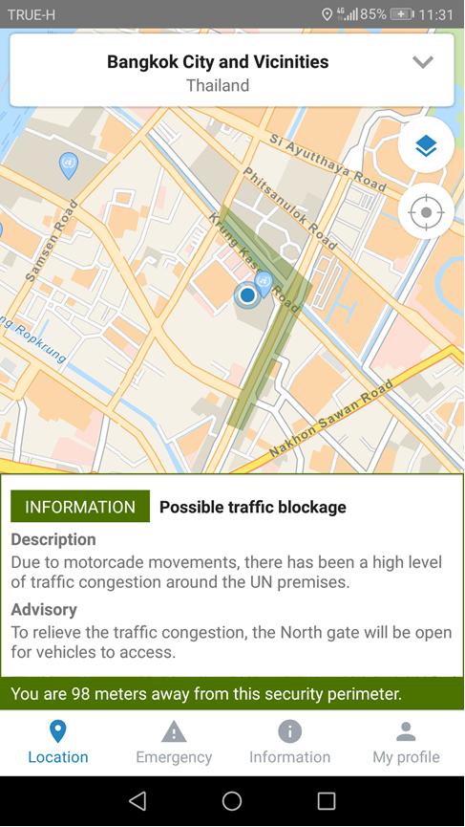
Security Notifications
Receive location-based security notifications (Information / Warning / Alert)
in Designated Areas, Security Areas, Risk Management Areas
in or near ad-hoc security notification area (geo-fencing)
List of past security notifications is saved on device
YOUR SAFETY, YOUR SECURITY, OUR PRIORITY
Notes:
When UNSMS security personnel need to reach you – they’ll do it using the APP!
You’ll receive security messages – including information only, warning and alerts as a pop-up notification to your device.
If warranted, security professionals will also provide you with advice on how to stay safe given the reason for the notification. For example, if there is a traffic blockage in your area, as in the example shown, security professionals let you know what you can do to avoid it.
Another added benefit, these notifications are all location-based, so if you enter an area that has an active notification, you’ll receive it just as you enter the area.

Slide 5
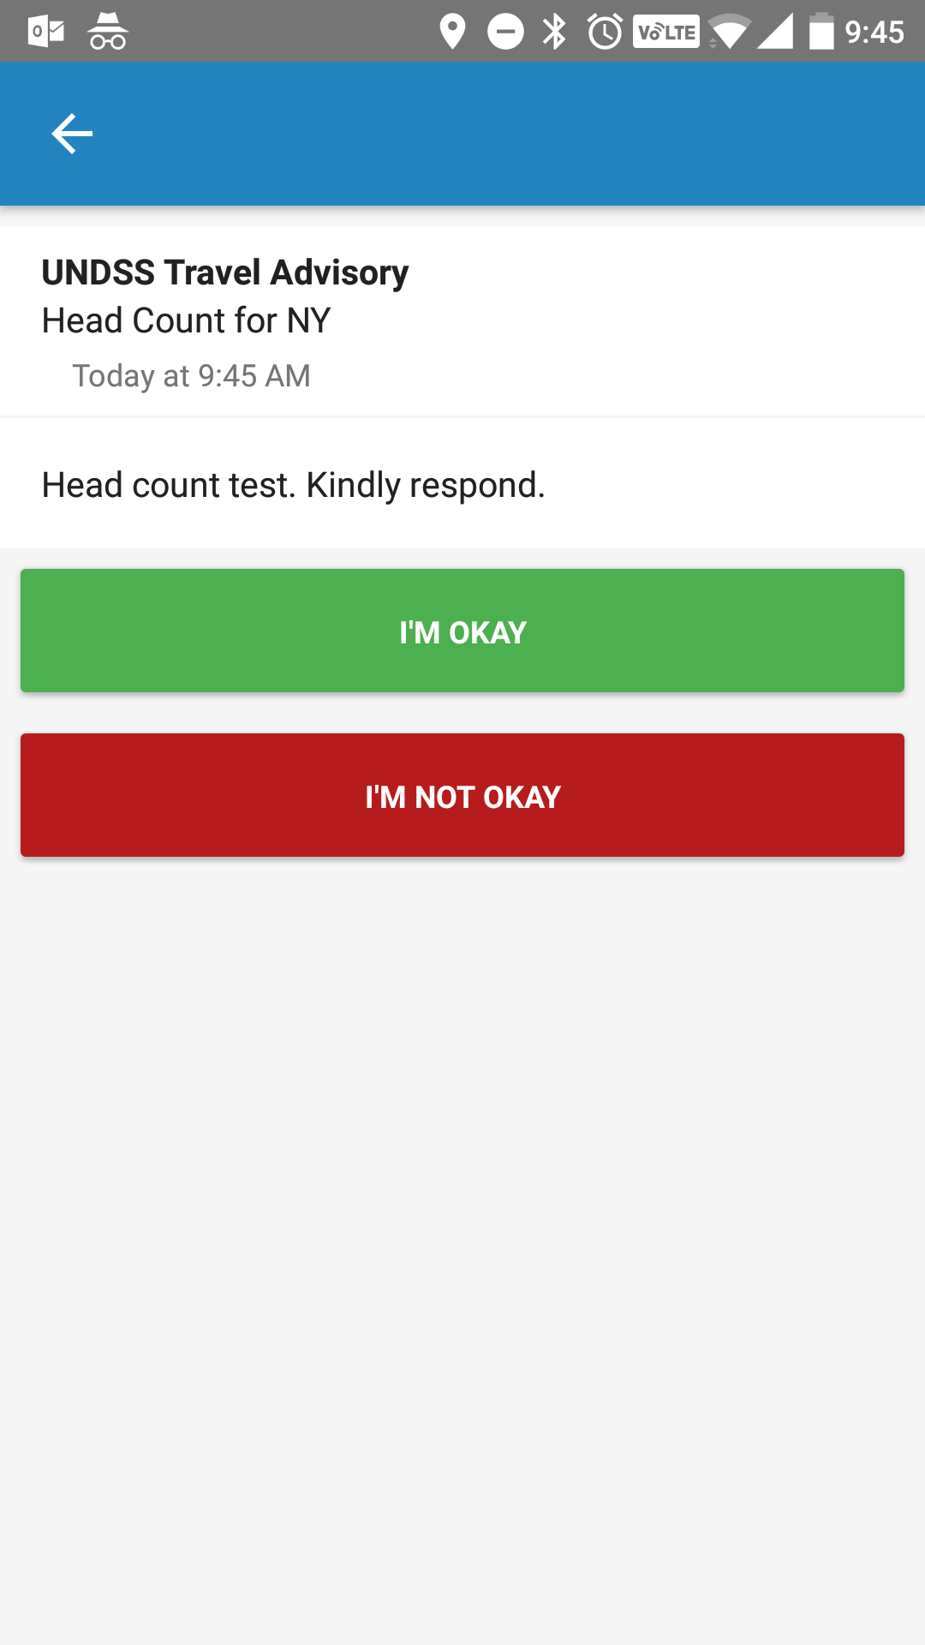
Request for Status
Receive requests for status
I’m okay
I’m not okay
in Designated Areas, Security Areas, Risk Management Areas
in or near ad-hoc security notification areas (geo-fencing)
During the pilot, there will be no response from UNDSS or any other entity if a user responds “I’M NOT OKAY” to any test message sent.
YOUR SAFETY, YOUR SECURITY, OUR PRIORITY
Notes:
The “Request for Status” or “Headcount” feature is a way for security professionals to know if you are OKAY or need assistance during an emergency or crisis situation. Security professionals can send a staff status request to all users in an area – including users who are traveling in the area – and at their own duty station. This allows your security professionals to know if you need help.
During the pilot, there will no response from UNDSS or any other entity if a user responds “I’m NOT OKAY” to a test message.

Slide 6
What do people think about the eTA?
72%
87%
98%
Felt safer using the app
Provides relevant security information
Intend to use it in areas with elevated risk
YOUR SAFETY, YOUR SECURITY, OUR PRIORITY
Notes:
What do people think about the eTA? They love it!
Respondents to a survey indicated that they see the usefulness of eTA as a tool for their security. A majority feel safer just having it. Almost everyone – 98% - will use it in areas with elevated risks.

Slide 7
What do people think about the eTA?
Responses indicate that effectively communicating the benefits of eTA in all environments is key
73%
67%
69%
43%
No reservations regarding privacy
No financial concerns
Likeliness to use increases based on location
Will use it full-time
YOUR SAFETY, YOUR SECURITY, OUR PRIORITY
Notes:
We wanted to know what reservations people had about the app. While the reasons for the hesitancy were already known – privacy and cost – in reality, relatively few people are concerned about these issues.
Likeliness to use it as risk increases also indicates that people see it as a security tool and will use it in areas where they feel relatively unsafe, but will reluctant to use it in areas where they feel more secure. The challenge for DSS is to get everyone to use it, everywhere.

Slide 8
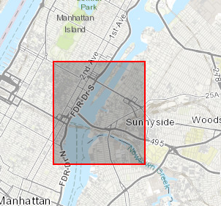
What did UNDSS do with this information?
73%
No reservations regarding privacy
Administrators see this
Geolocation is turned OFF
OICT is working on keeping costs down – right now, eTA costs about $.025/day
YOUR SAFETY, YOUR SECURITY, OUR PRIORITY
Notes:
We wanted to know what reservations people had about the app. While the reasons for the hesitancy were already known – privacy and cost – in reality, relatively few people are concerned about these issues.
Likeliness to use it as risk increases also indicates that people see it as a security tool and will use it in areas where they feel relatively unsafe, but will reluctant to use it in areas where they feel more secure. The challenge for DSS is to get everyone to use it, everywhere.
UNDSS suppressed the geolocation feature. Now, administrators cannot see nor search for individuals using eTA. The disadvantage is, if something goes wrong, we won’t be able to see where you are, and won’t be able to assist you as quickly. If it’s on, security personnel can immediately see where you are and if you’ve been potentially impacted by an event.

Slide 9
Security Professionals like it, too!
95%
53%
eTA will enhance security operations
Received expected results from the headcount functionality
YOUR SAFETY, YOUR SECURITY, OUR PRIORITY
Notes:
…Almost all security professionals surveyed see it as a benefit for security operations.
When we received the feedback about the headcount, we fixed it. It’s now a closed loop system that ensures each message from Command Center to App and back is sent and received on both ends.

Slide 10
Thank you
Questions?

