Slide 1
PROTECTION

Slide 2
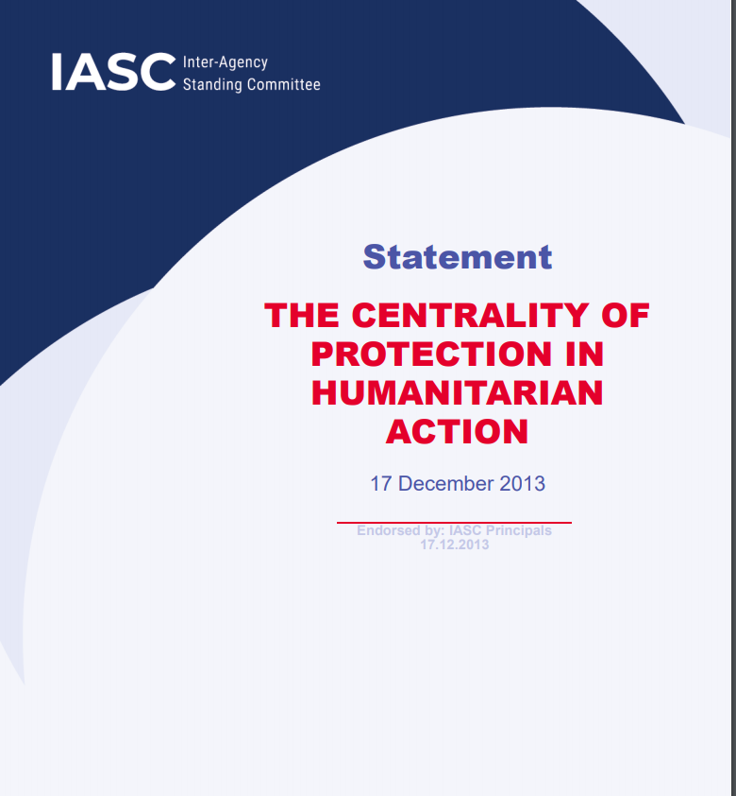
Protection is central to humanitarian action…
Protection is at the core of our work
Protection is a shared responsibility of all humanitarian actors;
Protection is an expected collective outcome of the humanitarian response;
Protection considerations informs all aspects of humanitarian action.
What is Protection?
Safety and dignity
IASC definition
  A legal responsibility
  A strategic objective
  An activity
Protection vs Protection of Civilians

Slide 3
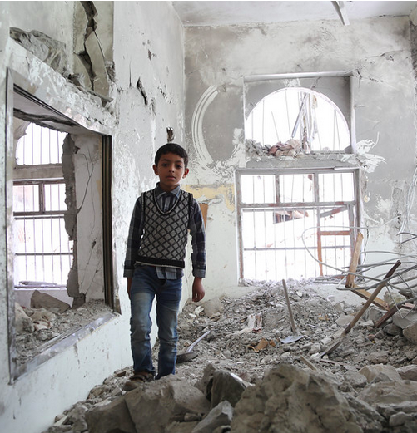
Definition of Protection
“... all activities aimed at obtaining full respect for the rights of the individual in accordance with the letter and the spirit of the relevant bodies of law (i.e. International Human Rights Law, International Humanitarian Law, International Refugee law.”
Inter-Agency Standing
Committee (IASC)

Slide 4

OCHA’s Protection Role
Based on its coordination mandate (46/182) and primary role to support and advise the ERC and HC fulfill their leadership responsibilities, while working in close collaboration with the protection cluster to achieve collective protection outcomes.

Slide 5
Achieving collective protection outcomes
At a minimum, and in cooperation with protection actors:
Protection risks are known and prioritized
→ Protection analysis tools; HNO and HRP Tip Sheets; HCT protection strategy guidance
Advocate and promote respect for International Humanitarian and Human Rights Law by all parties
→ HC talking points and speeches, public and media statements, information products, key messages on protection, #NotATarget campaign

Slide 6
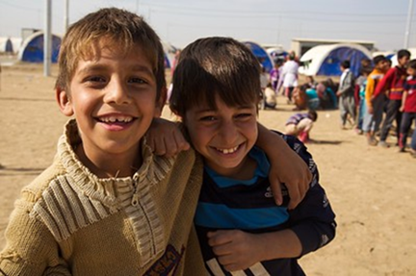
Achieving collective protection outcomes
At a minimum, and in cooperation with protection actors:
Incorporate protection and mainstream protection principles into all phases and across all sectors of the response
→ GPC Protection Mainstreaming Toolkit
Ensure sufficient funds are allocated to the protection response and contribute to sustaining protection efforts
→ Flash Appeals, CERF

Slide 7
Operational Protection Challenges
Sensitive nature of protection information
Humanitarian dilemmas
Do No Harm
Coordination and collaboration with integrated missions on PoC
Lack of Accountability
Access constraints

Slide 8
Useful Resources
IASC Policy on Protection in Humanitarian Action (2016)
IASC Centrality of Protection statement (2013)
IASC Operational guidelines on protection of persons in situations of natural disasters (2011)
IASC Guiding Principles on Internal Displacement (1999)
OCHA on Message – Protection
Protection Essentials for OCHA Field Offices (in development)
Global Protection Cluster website http://www.globalprotectioncluster.org/
Access and Protection Teamsite

Slide 9
Conclusion
Key take-aways:
Protection and Access are a shared responsibility. All OCHA staff have a role to play in supporting the access agenda.
OCHA needs to be more systematic and predictable in its way it approaches access and protection. A strong analysis is the backbone of any access or protection action plan.
Best practices, guidance and tools exist. They are captured in the Minimum Package of Services on Access. A Protection Essentials is under development.
PAPS is available to support you in the implementation of the access and protection portfolio.

